Slide 1
Transformer-Based Ensemble for AI-Generated Text Detection
Venkatesh Makkena

Slide 2
AGENDA
Introduction​
Background & Need
​Related Work
Dataset
​Approach
​Pipelines and individual model outcomes
Conclusion and Future work.

Slide 3
Introduction
The paper "Stacking the Odds: Transformer-Based Ensemble for AI-Generated Text Detection" delves into the increasingly important challenge of distinguishing AI-generated text from human-authored content. In an era where advanced language models like GPT can produce highly convincing text, this research addresses the pressing need for effective detection methods.
This study represents a significant advancement in the field, combining cutting-edge technology with practical applications in safeguarding digital communication.

Slide 4
Back Ground
Understanding Transformers: The backbone of modern language models enabling breakthroughs in natural language processing

Slide 5
Need
- Combating Misinformation and Fake News
-Academic Integrity
- Legal and Ethical Implications
- Security and Fraud Detection
- Preserving Human Element in Communication
- Transparency in Media and Advertising

Slide 6
Related Work
Stylometric attribution
Deep learning: GLoVe-based attribution
Deep learning: Energy-based attribution
Statistical attribution
Hybrid attribution:
TDA-based Detector
Fingerprint Detector
FAST
CoCo

Slide 7
Current Approach
Choice of Models:
Uses ALBERT, ELECTRA, RoBERTa, and XLNet.
Three subsets of the dataset are presented:
Training, validation, and testing.
The training set contains 18,000 entries, and the validation and testing each contains 2,000 entries
Each row has Text and result if it is 0 then AI made, else human made text.

Slide 8
Models
ALBERT : It is a modification of BERT (Devlin et al., 2018) which reduces its memory consumption and increases the training speed by repeating layers split among groups and splitting the embedding matrix into smaller matrices, whilst being more performative than BERT in GLUE, RACE, and SQuAD.
ELECTRA : is another modification of BERT that changes the pretraining
objective, as inspired by GAN where ELECTRA acts as the discriminator which predicts whether a token in a randomly masked text is original or generated by the generator (which we train simultaneously). This approach makes ELECTRA
perform comparably to larger models whilst using
a lot less compute.

Slide 9
Models
RoBERTa: optimises BERT in four aspects of training: using full-sentences without Next Sentence Prediction (NSP) loss, with dynamic masking, with larger
mini-batches, and with a larger byte-level BytePair Encoding (BPE).
XLNet uses a generalised autoregressive pretraining method that maximises the ‘expected likelihood over all permutations of the input sequence factorisation order’ enabling bidirectional contexts and overcoming BERT’s pretrain-finetune discrepancy due to neglecting masked positions dependency

Slide 10
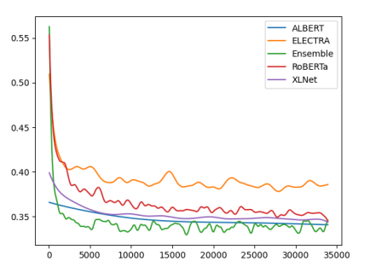
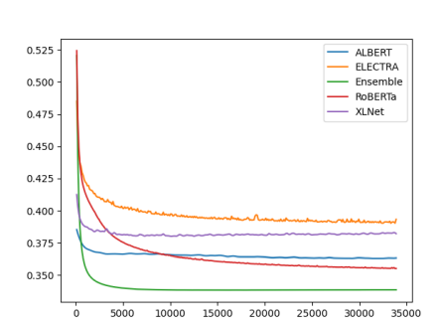
Training Loss
Validation Loss

Slide 11
Results:
Model | Accuracy
ELECTRA | 0.9311
XLNet | 0.9361
ALBERT | 0.9567
RoBERTa | 0.9572
Ensemble | 0.9694

Slide 12
Conclusion
This paper discusses an ensemble of Transformer-based models that combined using a logistic regression classifier to predict if a text was generated by AI and achieved an accuracy of 0.9555 using a stacking ensemble of basic encoder only Transformer models.

Slide 13
Future Work
It would be beneficial to integrate other non-Transformer-based weak learners to improve training.
In addition, it would also be useful to perform data augmentation which can help to generalise the model.
It has been shown that the RoBERTa detector can be attacked easily through misspelling. It would also be helpful to build detectors that are resilient in this regard.

Slide 14
THANK YOU

